Slide 1
Why are Foreign Firms Listed in The U.S. Worth More?
財金所 周立軒

Slide 2
Agenda
Motivation
Surveys and Hypothesis
Data
Experiment & Result
Conclusion

Slide 3
Motivation
Surveys find many benefits from listing in U.S
Lowers cost of capital
Access to foreign capital
Increase the liquidity
Prestige
But, there are some interesting questions…
Why we do not see more foreign companies listed in U.S?
Do those companies listed in U.S really perceive more benefits?
Is there any conflict in benefits between Controlling Share Holders and other share holders?

Slide 4
Surveys and Hypothesis
From the Wolrdscope database , the Tobin’s q of listed companies are higher then non-listed companies from the same country about 16.5%
And the difference of “q”, is so-called Cross-Listing Premium

Slide 5
Surveys and Hypothesis
La Porta, Lopez-de-Silanes, and Shleifier (1999) shows that large firms are typically controlled by large share holders, mostly families.
And Stulz(1990) shows : Agency cost of managerial discretion are negatively related to growth opportunities.

Slide 6
Surveys and Hypothesis
Agency cost comes from the conflict in benefits between Controlling Share Holders and Managers.
The private benefits of Controlling Share Holders will be lower if the protection for investors become stronger.

Slide 7
Surveys and Hypothesis
Lins, Strickland, and Zenner(2000) shows that firms listed in U.S become less credit-constrained.
Cantale (1996), Fuerst (1998), and Moel (1999) assume information asymmetry are related to the decision of listing in oversea markets.

Slide 8
Truth and Hypothesis
Due to these surveys, we summarize four main hypothesis
H1: Firms listed in U.S have Cross-Listing Premium comparing to non-listing firms from the same country
H2: Listing in U.S can improve stocks’ liquidity and efficiency, so the stocks are more valuable

Slide 9
Truth and Hypothesis
H3: Listing in U.S improves the degree of information disclosure.
H4: Because of the high investors protection in U.S, Controlling Share Holders’ private benefits are limited, and this lower the agency cost , so firms gain more growth opportunities.

Slide 10
Data
For evaluating the Tobin’s q , the formula is:
Country-Level variables are from LLSV(1998), they are legal origins, index of anti-director rights, and the index of judicial efficiency.

Slide 11
Data
Additionally, numbers of other variables are employed
Information Disclosure: Index of Accounting Standards produced by Center For International Financial Analysis and Research
Liquidity:
Capital Accessibility: Capital Access Index, developed by the Millken Institute.

Slide 12
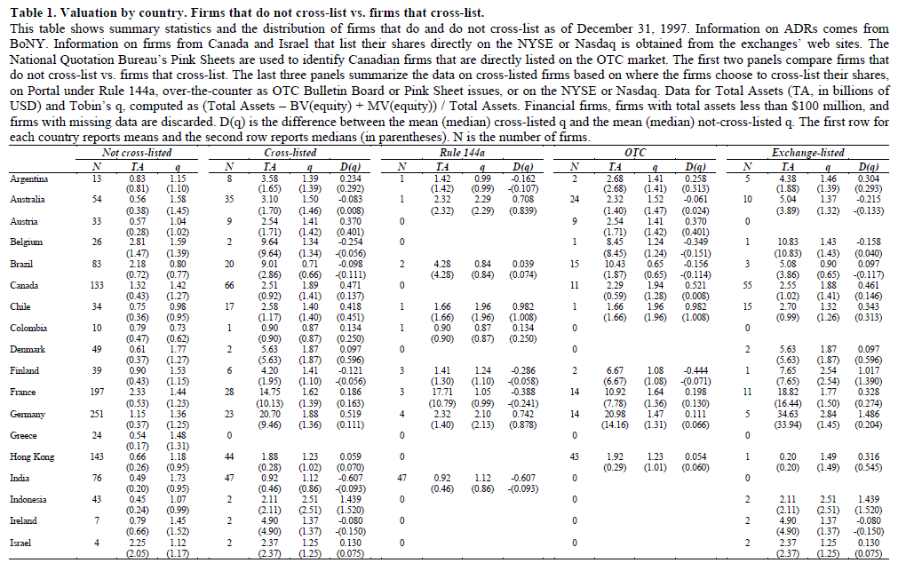
Experiment & Result

Slide 13
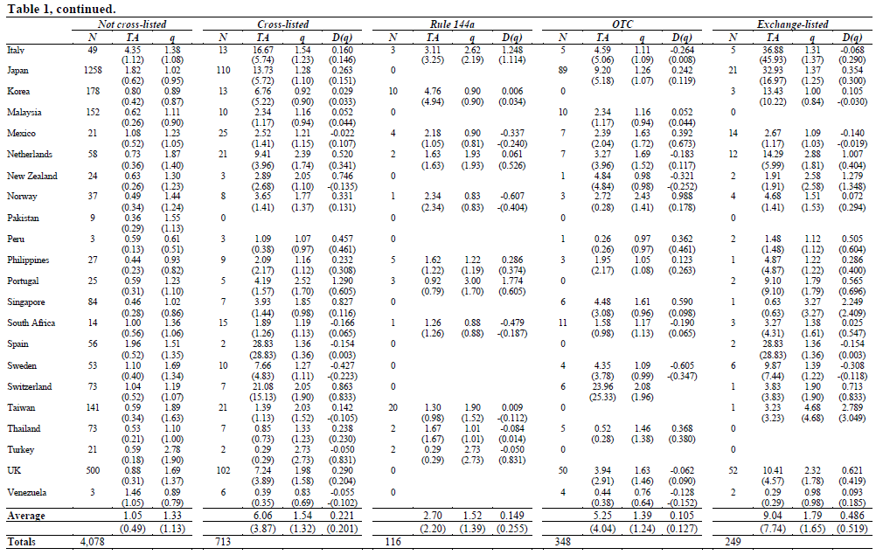
Experiment & Result

Slide 14
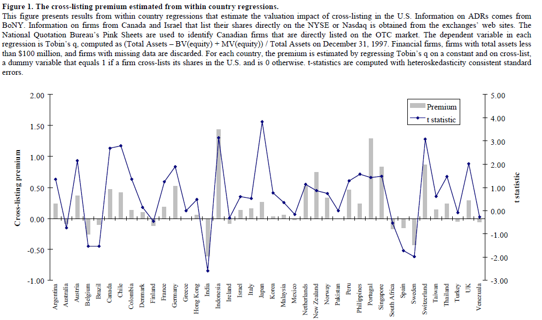

Slide 15
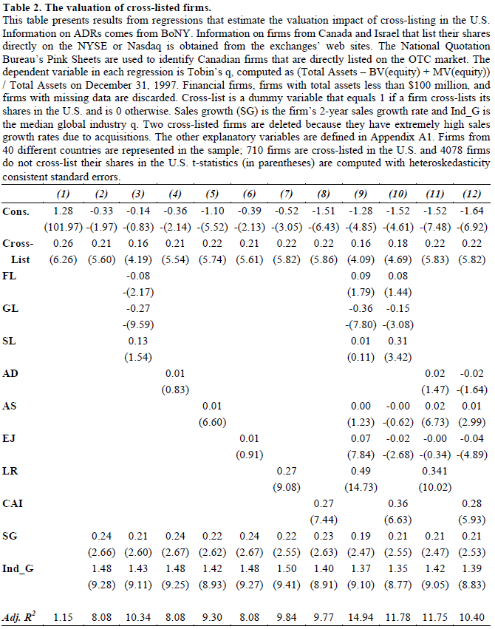

Slide 16
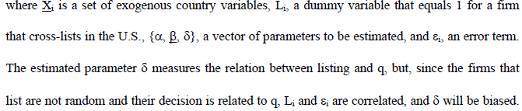
Experiment & Result
Reduce the country-select bias, now we employ Heckman(1979) correction to control the self-selection bias
To exam the effect of a listing on q, we define q as

Slide 17
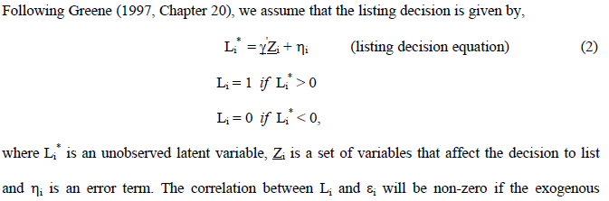
Experiment & Result

Slide 18
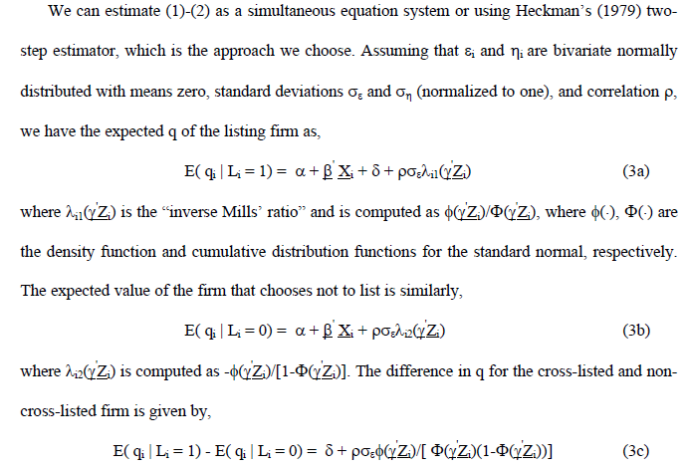
Experiment & Result

Slide 19
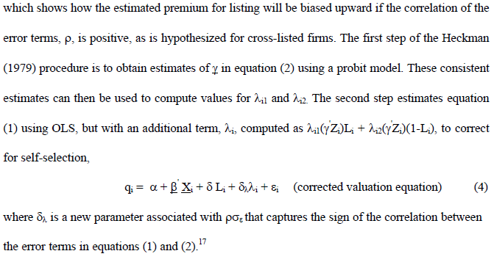
Experiment & Result

Slide 20
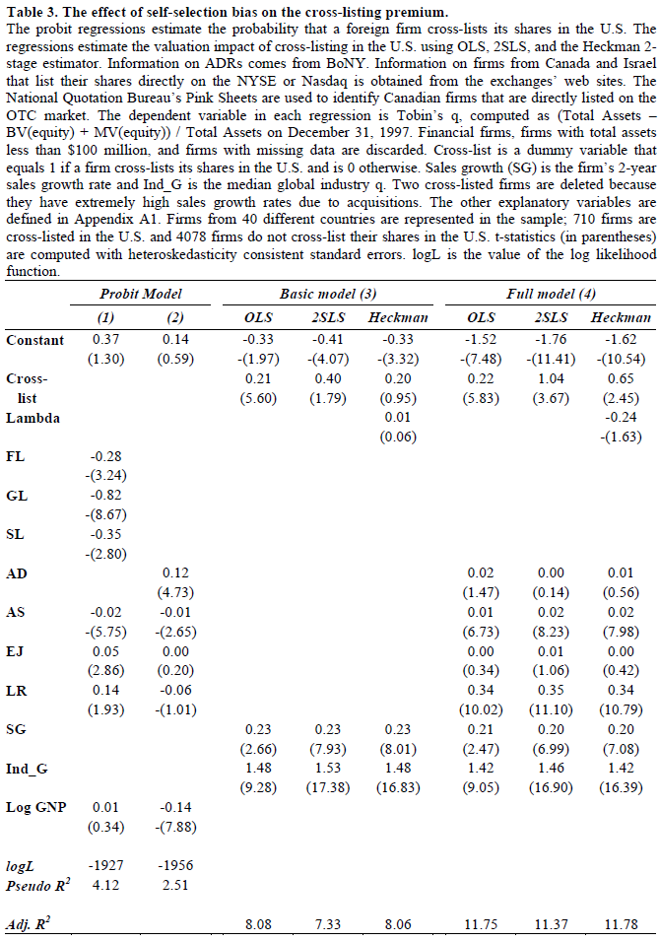
Experiment & Result

Slide 21
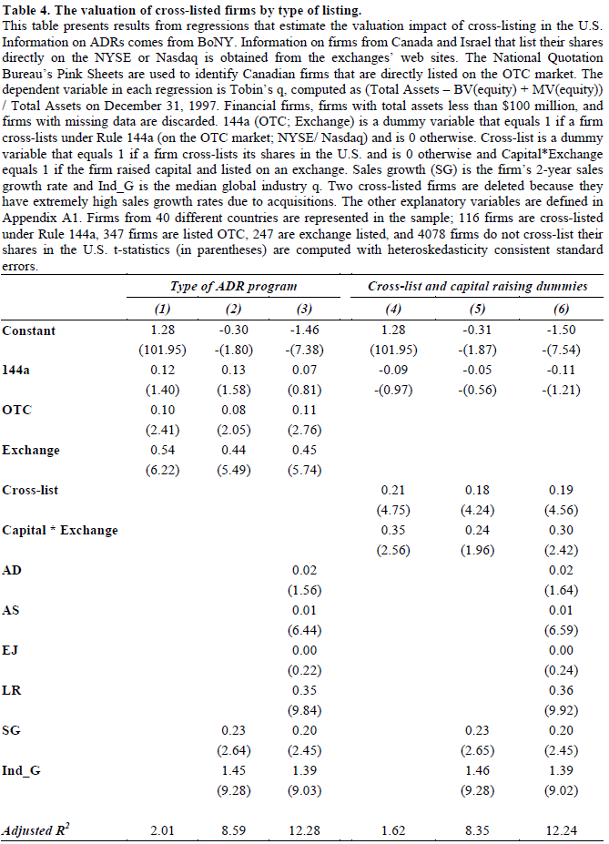
Experiment & Result

Slide 22
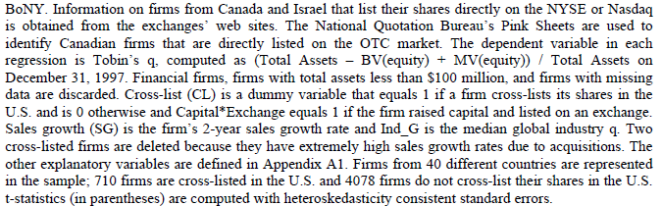

Slide 23
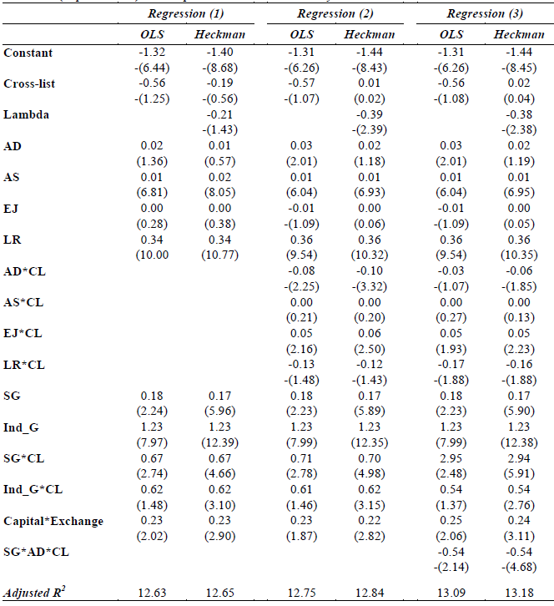

Slide 24
Conclusion
The result shows:
Listed firms do have higher valuations then those non-listed
Listing in U.S usually represent the lower agency cost, lower cost of capital, higher investor protection, and result more growth opportunities
Self-select control seems not affect the result

